Slide 1
Open Records Act Compliance Update
Finance and Executive Committee
April 29, 2023
Kristen Denius
Chief Transparency Officer

Slide 2
Public Record Requests to the City of Atlanta
Requests for public records can be received and responded to electronically, via US Mail, or in person where possible.
Open records officers within each department monitor dedicated open records email inboxes for electronic requests.
Open records management software will include an online portal for the submission of requests.
Transparency web page provides resources for individuals seeking records or in need of assistance with a request.

Slide 3
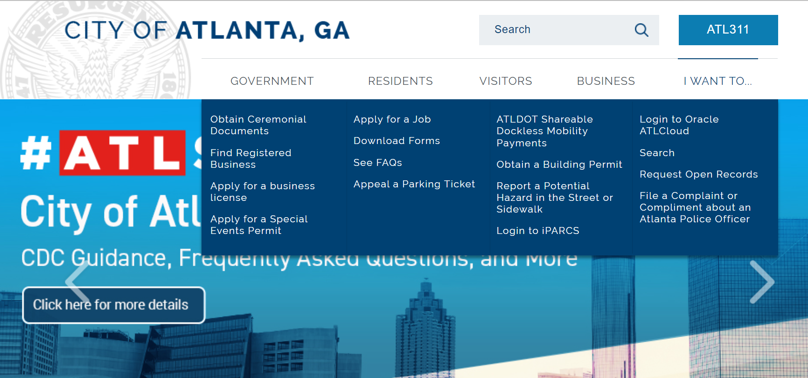

Slide 4
Open Records Management Software Project Update
Apr 2020
RFP-S 1200331, Citywide Public Records Management was advertised to the public on April 20, 2020.
Aug - Dec 2020
Responses from proponents received in August 2020.
Evaluations conducted in December 2020 by cross-departmental evaluation team including Law, Transparency, AIM, Aviation, Watershed, and Police.
Spring/Summer 2021
The project team submitted a recommendation for award to the Chief Procurement Officer in February 2021.
Resolution 21-R-3489 authorizing the award of a contract to AINS, Inc. Adopted in May 2021. Contract executed in June 2021.
Jan – Sept 2022
Implementation and configuration of FOIAXpress software.
Functionality testing and internal staff training.
Fall 2022
Upgrade to newest version of software complete.
Nov 2022 – Feb 2023
Feb 2023 - present
Implementation of internal training program.
Anticipated go-live: Summer 2023
Implementation of enterprise-wide Single Sign On (SSO).
Functionality testing of FOIAXpress and PAL.
Development of internal training materials.

Slide 5
Goals for FOIAXpress Software Implementation
Compliance with Atlanta City Code Section 3-31(4):
Sec. 3-31. - City of Atlanta open records website.
The city shall create and maintain a website dedicated to open records compliance, which shall include, but not be limited to:
(1)The name and contact information for the transparency officer and any assistant transparency officers;
(2)A list of all designated city records custodians and city records coordinators;
(3)Contact information, both telephone number and email, for all designated city records custodians and city records coordinators;
(4)An online form or portal for submitting a request for open records;
(5)A link to the most current open records policies and procedures as promulgated by the transparency officer;
(6)A copy of the city's internal Georgia Open Records Act compliance training materials;
(7)A link to the city hotline email and telephone number for reporting alleged violations of the Georgia Open Records Act;
(8)A link to the city's records retention schedule;
(9)A link to the website of the Georgia Attorney General's Office.
(10)Frequently asked questions related to requesting and receiving open records; and
(11)Copies of any reports, assessments, or evaluations generated by the transparency officer.
Streamline the process for submission of public record requests, including via an online portal.
Standardize the procedures for responding to requests.
Allow for online payment of fees for records where applicable.
Allow for the tracking of request status by a requester and the sending of automatic status updates.
Allow for access to responsive records through the portal.
Allow for internal tracking of requests and deadline reminders.
Audit log of all system activities to allow analysis of compliance and establishment of performance metrics.
Reading Room of previously provided records.

Slide 6
Open Records Compliance Training
Open Records Compliance Training is now a module in the New Employee Orientation virtual training program.
Continuing development of Self-paced online training module for annual training of all employees in cooperation with HR.
Targeted training available on demand, either in-person or virtually.

Slide 7
Questions

