Slide 1


Jason Winton – Director, Inspections Services
Katrina Hickerson – Manager, Landlord Services
Kristopher Carter – Senior Housing Counselor
INTRODUCING AH’S housing choice voucher program (HCVP)
October 30, 2024

Slide 2







AGENDA
Common Misconceptions about the HCVP
The Need for Affordable Housing
AH Families and their Obligations
Why Do Business with AH? – Landlord Incentives
How the Rent Works
How to Do Business with AH

Slide 3
HCVP
COMMON MISCONCEPTIONS ABOUT THE HCVP
HCVP Participants do not have to work
HCVP Participants will damage my property
You never speak to the same person twice when you call Atlanta Housing and customer service is lacking
AH does not pay market rate rents
Property owners cannot screen tenants the same way as market renters
It takes months to get a tenant leased up and to receive payments

Slide 4
HCVP
THE NEED FOR AFFORDABLE HOUSING
The demand for vouchers is so high that the majority of housing agencies have closed their waiting list.
Agencies are often flooded with applications when waitlists reopen.
Families that manage to get on a waitlist often wait years to receive a voucher.
Surging demand and long waiting lists provide further evidence that the need for affordable housing far outstrips the supply.
Voucher funding levels are inadequate to address the growing rental affordability crisis.
Atlanta Housing (AH) operates the largest Housing Choice Voucher Program (HCVP) in the State of Georgia, serving approximately 11,000 households.

Slide 5
HCVP
ATLANTA HOUSING FAMILIES
95.1% of Atlanta Housing’s families earn less than $24,000 per year

Slide 6
HCVP
PARTICIPANT ELIGIBILITY
At admission and recertification, AH verifies household income, employment and work requirement compliance status of all new applicants and participants.
The work requirement helps families overcome the deterrents to work by offering positive incentives to address barriers to employment. AH’s Human Development Services Team assists families with work preparedness services, employment counseling, education, job training, and childcare referrals.
AH’s work requirement is enforced across its programs through the flexibility provided by AH’s Moving-to-Work (MTW) designation and requires work eligible participants to work a minimum number of hours per week.

Slide 7
HCVP
THE WORK REQUIREMENT: A CLOSER LOOK
All other Target Household members of the household (age 18 – 61) must be:
Either legally employed on a full-time equivalent basis or for an average of 20 hours per week or self-employed in a legitimate business enterprise that is appropriately documented
Or attending school full-time
Or employed on a part-time basis and either attending school part-time basis or participating in an AH approved training program for a combined minimum average of 20 hours per week
At least one Target Adult member of the household (age 18 – 61) must be:
Either legally employed on a full-time equivalent basis or for an average of 20 hours per week or self-employed in a legitimate business enterprise that is appropriately documented

Slide 8
HCVP
WHY DO BUSINESS WITH ATLANTA HOUSING?
GUARANTEED AND TIMELY RENTAL INCOME
  No more chasing your money
  Money delivered by the 5th of every month
  Additional check run occurs on the 20th of every month
CONSISTENT AND AVAILABLE TENANTS
  Our residents rarely move
  We have a pool of tenants always searching
MONETARY INCENTIVES AND MARKET RATE RENTS
  Get paid to do business with AH
  We pay market rate rents

Slide 9
HCVP
LANDLORD INCENTIVES AND PROGRAM ENHANCEMENTS
Area of Focus | Enhancement | Description | Implementation Date
Inspections | Initial Inspection Self-Certification for Large Multi-family Communities (10-12 days to lease up) | Owner and Tenant self-certify that unit meets AH Inspection Standards for New Lease Up Inspections (must score an 87 or greater on Property Assessment Inspection) | 2/2016
Inspections | Streamlined Inspection Standards | Streamlined and eliminated requirements where possible as well as implemented a more user friendly checklist | 2/2016 & 1/2020
Inspections | Annual Inspection Scheduling Change | Two hour appointment window for landlords and four hour appointment window for tenants | 7/2019
Inspections | Biennial Inspections | Pass two consecutive years’ inspections (Initial/Annual or Annual/Annual) on first attempt and skip the next year’s inspection | 3/2021

Slide 10
HCVP
LANDLORD INCENTIVES AND PROGRAM ENHANCEMENTS
Area of Focus | Enhancement | Description | Implementation Date
Landlord Services | Landlord Advisory Group | Landlords can join this group to give feedback to AH on how we can improve the HCVP and better serve our customers | 10/2014
Landlord Services | Dedicated Account Representatives | Each landlord has an assigned team of Portfolio Administrators available to address non-routine inquiries | 10/2015
Landlord Services | Investor Referral Incentive | Provide a $100 incentive to current landlords who refer a new landlord to the HCVP and they become a vendor | 5/2017
Landlord Services | New Property Owner Portal | New portal has more customer friendly features such as ability to see status of RTAs and rent increase requests, ability to submit documents on-line, and improved ease of use and customer service functionality | 10/2017
Landlord Services | Property Protection Program | AH will reimburse property owners up to $2,000 ($250 deductible) for excessive tenant caused damages to a unit | 11/2017
Landlord Services | Paperless Landlord Correspondence | AH sends all landlord related correspondence via email to the email address on file with AH | 4/2018

Slide 11
HCVP
LANDLORD INCENTIVES AND PROGRAM ENHANCEMENTS
Area of Focus | Enhancement | Description | Implementation Date
Landlord Services | Online Property Owner Briefing | Allow prospective landlords to complete the required Property Owner Briefing online | 1/2020
Landlord Services | Online Property Owner Application | Allow prospective landlords to complete their application and submit online | 1/2020
Landlord Services | E-signature of New Contracts | New contracts are sent to landlords and tenants for electronic signature | 4/2020
Rent Determination | Up-front Rent Estimates | For all multi-family communities and upon request for single family units, AH will provide a rent estimate for property owners who are considering placing new unit on the HCVP | 5/2017
Rent Determination | New Payment Standards (Maximums) | Maximum rent amount that can potentially be received by a landlord was increased; payment standards are reviewed every two years; latest review and implementation as of October 2021 resulted in a 23% increase to the allowable payment maximums | 10/2021
Rent Determination | Energy Efficiency Rent Boost (EERB) | Both single family units and multi-family communities can earn up to $175 for energy efficient upgrades to the unit; AH Landlords may also apply for the Sustainable Energy Efficiency Rental (SEER) Loan if they wish to seek capital to make these energy efficiency improvements | 11/2021

Slide 12
HCVP
LEASE UP INCENTIVES
AUTOMATIC LEASING INCENTIVE FEE (LIF)
  Atlanta Housing pays a one-time, non-refundable, monetary payment to property owners on behalf of NEW applicants who submit their Request for Tenancy Approval (RTA) within the first 60 days of receiving their voucher.
STANDARD LEASING INCENTIVE FEE (LIF)
  Atlanta Housing pays a one-time, non-refundable, monetary payment to property owners on behalf of Atlanta Housing participants who are already on the program experiencing a hardship and who have not received a LIF within the last 5 years. Examples of hardships could include:
    Financial burden
    Credit issues

Slide 13




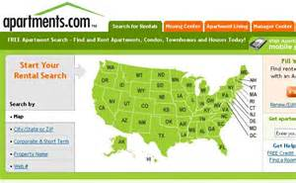

HCVP
HOUSING FAIRS AND HOUSING TOURS
MARKETING YOUR UNIT
  AH Housing Fairs and Tours: These events allow tenant prospects to meet prospective landlords at AH Headquarters or allows AH to bring the tenant prospects to the landlords at the available unit. Housing Fairs occur every other Thursday.
Property owners should still screen and select a tenant using their criteria.

Slide 14
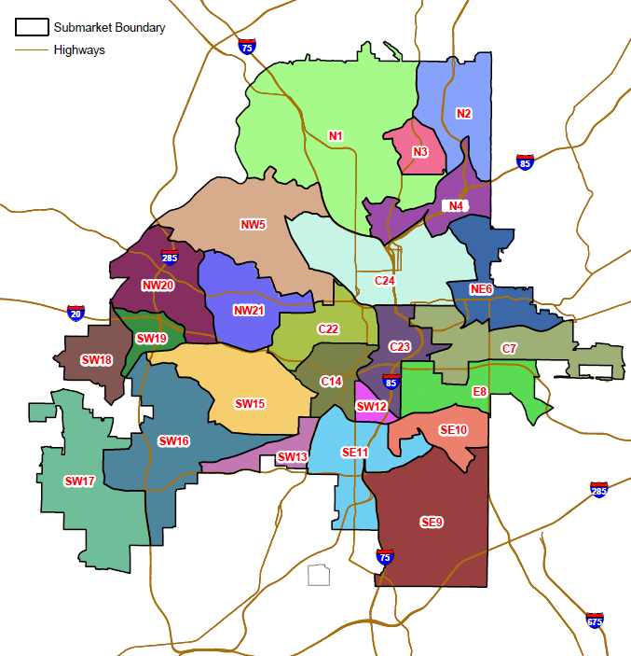
ATLANTA SUBMARKETS AND PAYMENT STANDARDS (MAXIMUM RENTS)
SUBMARKET NAME | EFFICIENCY | 1-BR | 2-BR | 3-BR | 4-BR | 5-BR | 6-BR
N1 | $1,500 | $1,850 | $2,600 | $3,250 | $4,400 | $4,750 | $5,600
N2 | $1,500 | $1,850 | $2,600 | $3,250 | $3,600 | $4,150 | $4,500
N3 | $1,500 | $1,850 | $2,600 | $3,250 | $3,950 | $4,550 | $5,250
N4 | $1,500 | $1,850 | $2,600 | $3,250 | $3,600 | $4,050 | $4,500
NW5 | $1,500 | $1,850 | $2,600 | $3,250 | $3,600 | $4,050 | $4,500
NE6 | $1,500 | $1,850 | $2,600 | $3,250 | $3,600 | $4,200 | $4,500
C7 | $1,500 | $1,850 | $2,600 | $3,250 | $3,600 | $4,050 | $4,500
E8 | $1,500 | $1,850 | $2,600 | $3,250 | $3,600 | $4,300 | $4,500
SE9 | $1,150 | $1,500 | $1,750 | $2,400 | $2,800 | $3,200 | $3,500
SE10 | $1,500 | $1,800 | $2,450 | $2,900 | $3,150 | $3,400 | $3,500
SE11 | $1,150 | $1,300 | $1,550 | $2,200 | $2,450 | $2,750 | $3,000
SW12 | $1,150 | $1,200 | $1,400 | $1,900 | $2,000 | $2,200 | $2,500
SW13 | $1,150 | $1,250 | $1,300 | $1,600 | $2,000 | $2,200 | $2,300
C14 | $1,500 | $1,600 | $1,900 | $2,550 | $3,050 | $3,450 | $3,750
SW15 | $1,150 | $1,200 | $1,300 | $1,750 | $2,000 | $2,300 | $2,500
SW16 | $1,350 | $1,450 | $1,550 | $2,050 | $2,450 | $2,750 | $3,000
SW17 | $1,500 | $1,850 | $2,600 | $3,250 | $3,600 | $4,050 | $4,400
SW18 | $1,350 | $1,450 | $1,550 | $2,050 | $2,450 | $2,750 | $3,100
SW19 | $1,150 | $1,250 | $1,300 | $1,600 | $2,000 | $2,100 | $2,300
NW20 | $1,150 | $1,250 | $1,600 | $1,900 | $2,100 | $2,400 | $2,650
NW21 | $1,150 | $1,250 | $1,600 | $1,900 | $2,200 | $2,400 | $2,650
C22 | $1,500 | $1,750 | $2,100 | $2,850 | $3,350 | $3,800 | $4,150
C23 | $1,500 | $1,850 | $2,600 | $3,250 | $3,700 | $4,050 | $4,500
C24 | $1,500 | $1,850 | $2,500 | $3,250 | $3,700 | $4,200 | $4,300
Please note: The amounts above are the maximum rents that may be paid; rents are determined based on an analysis of current rents for comparable units, preferably within the submarket, or within close vicinity of the subject unit.

Slide 15
HCVP
HOW THE RENT WORKS
DETERMINING THE TENANT’S RENT PORTION
Once the contract rent is determined, a portion of that rent may be the responsibility of the tenant.
TOTAL CONTRACT RENT | $1,000.00 | Based on rent determination.
TENANT RENT TO OWNER | - $300.00 | 30% of household’s monthly adjusted income. (Ex: $1000/mo.) Paid from household directly to Property Owner.
HOUSING ASSISTANCE PAYMENT | $700.00 | Paid directly from AH to Landlord via ACH.

Slide 16
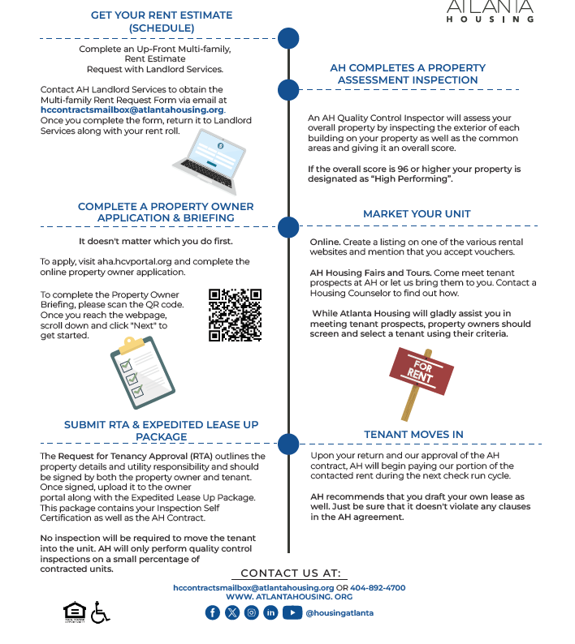

DOING BUSINESS WITH
AH: MULTI-FAMILY

Slide 17
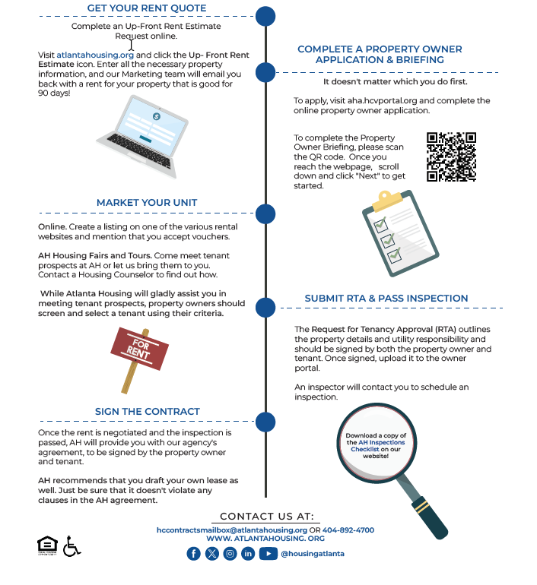

DOING BUSINESS WITH
AH: SINGLE FAMILY

Slide 18

THANK YOU
@housingatlanta
www.atlantahousing.org

