Slide 1
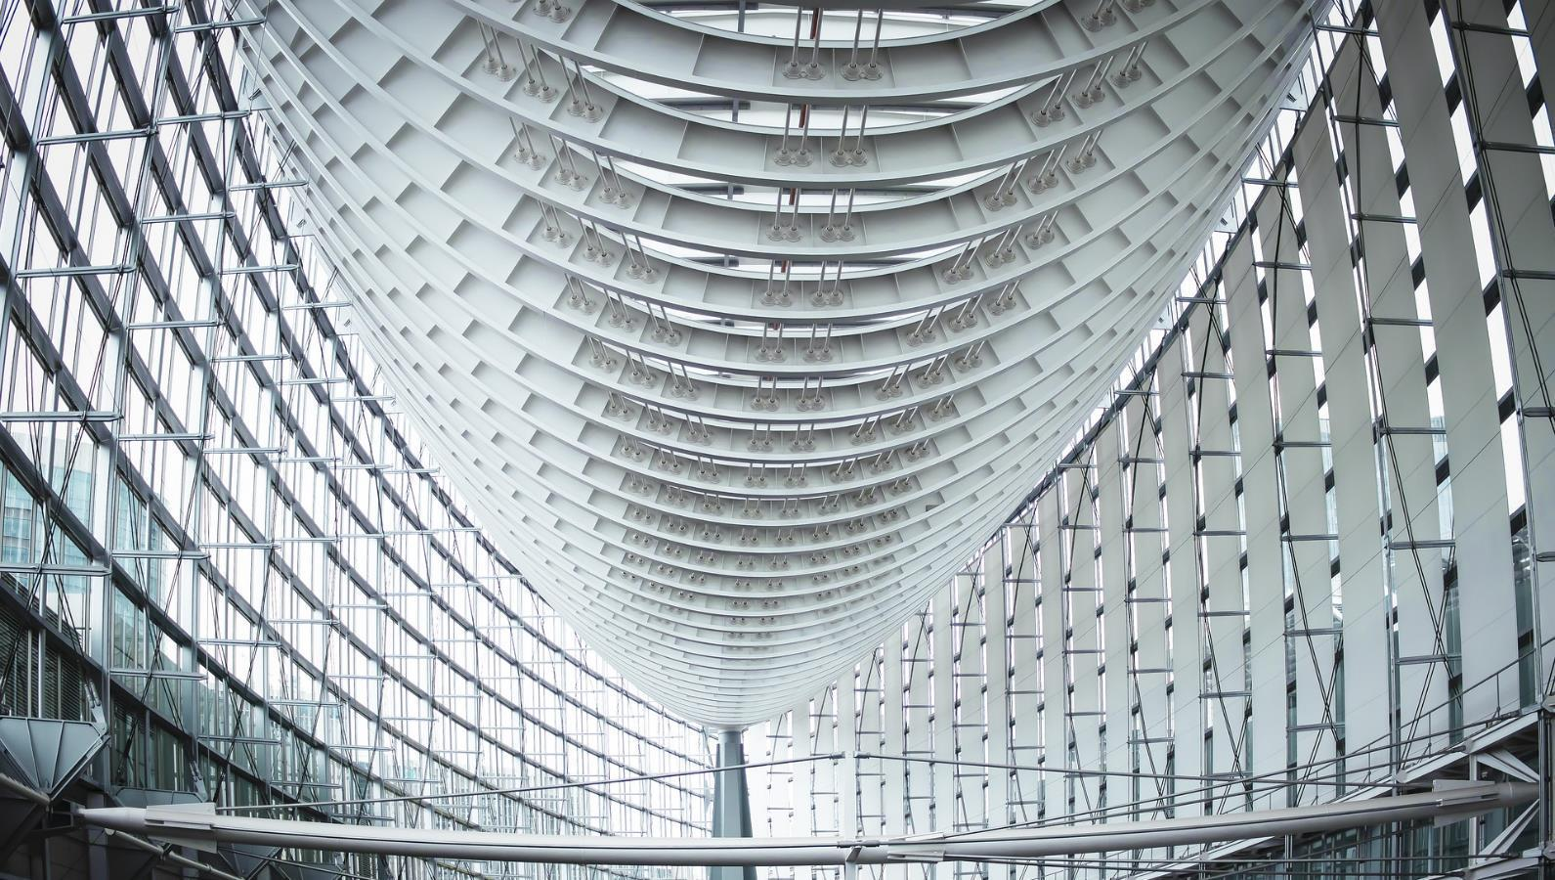
Affordable Housing Week

Slide 2
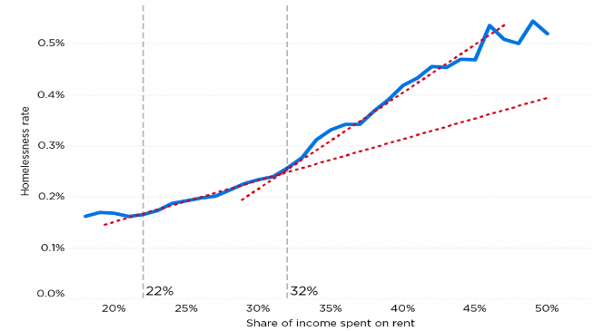
Why Affordable Housing Matters
Lack of Affordable Housing Can Spiral into Homelessness
Housing Affordability and Homelessness¹
Lack of affordable housing has been cited numerous times as the number one contributing factor to homelessness
Spending of over 30.0% of income on rent is considered cost burdened by Federal standards
At 22.0% of income spent on rent, the rate of homelessness increases notably
At 33.0% of income spent on rent, the rate of homelessness increases dramatically
Three states and Washington D.C. comprise the entire top 10 continuums of care with the highest rates of homelessness
California (6 times)
Massachusetts (2 times)
New York (1 time)
Washington D.C. (1 time)
Rate of Homelessness by Continuum of Care²
(Rate Per 10,000 People)
Zillow Economic Research.
National Alliance to End Homelessness: State of Homelessness: 2021 Edition.
National Alliance to End Homelessness.

Slide 3
Societal Impact of Homelessness
Societies Ultimately Bear the Burden of Homelessness
Permanent Supportive Housing as a Solution¹
Homelessness can have a substantial impact on society, with the estimated cost of a chronically homeless individual to be $40,448 annually
Once an individual has experienced homelessness, it is difficult to recover
One proven solution is permanent supportive housing (PSH), which has been estimated to reduce the societal burden of a chronically homeless individual to ~$20,000
PSH has also been proven to dramatically reduce the recidivism rate to chronic homelessness
The risk of returning to homelessness could be as low as ~5%²
Using traditional methods, this could be as high as ~58% for individuals without children³
Return to Homelessness (PSH vs. Transitional Housing)^{2,3}
United States Interagency Council on Homelessness: Ending Chronic Homelessness in 2017.
Family Options Study, 2015.
Wilder Research Foundation, 2015.

Slide 4
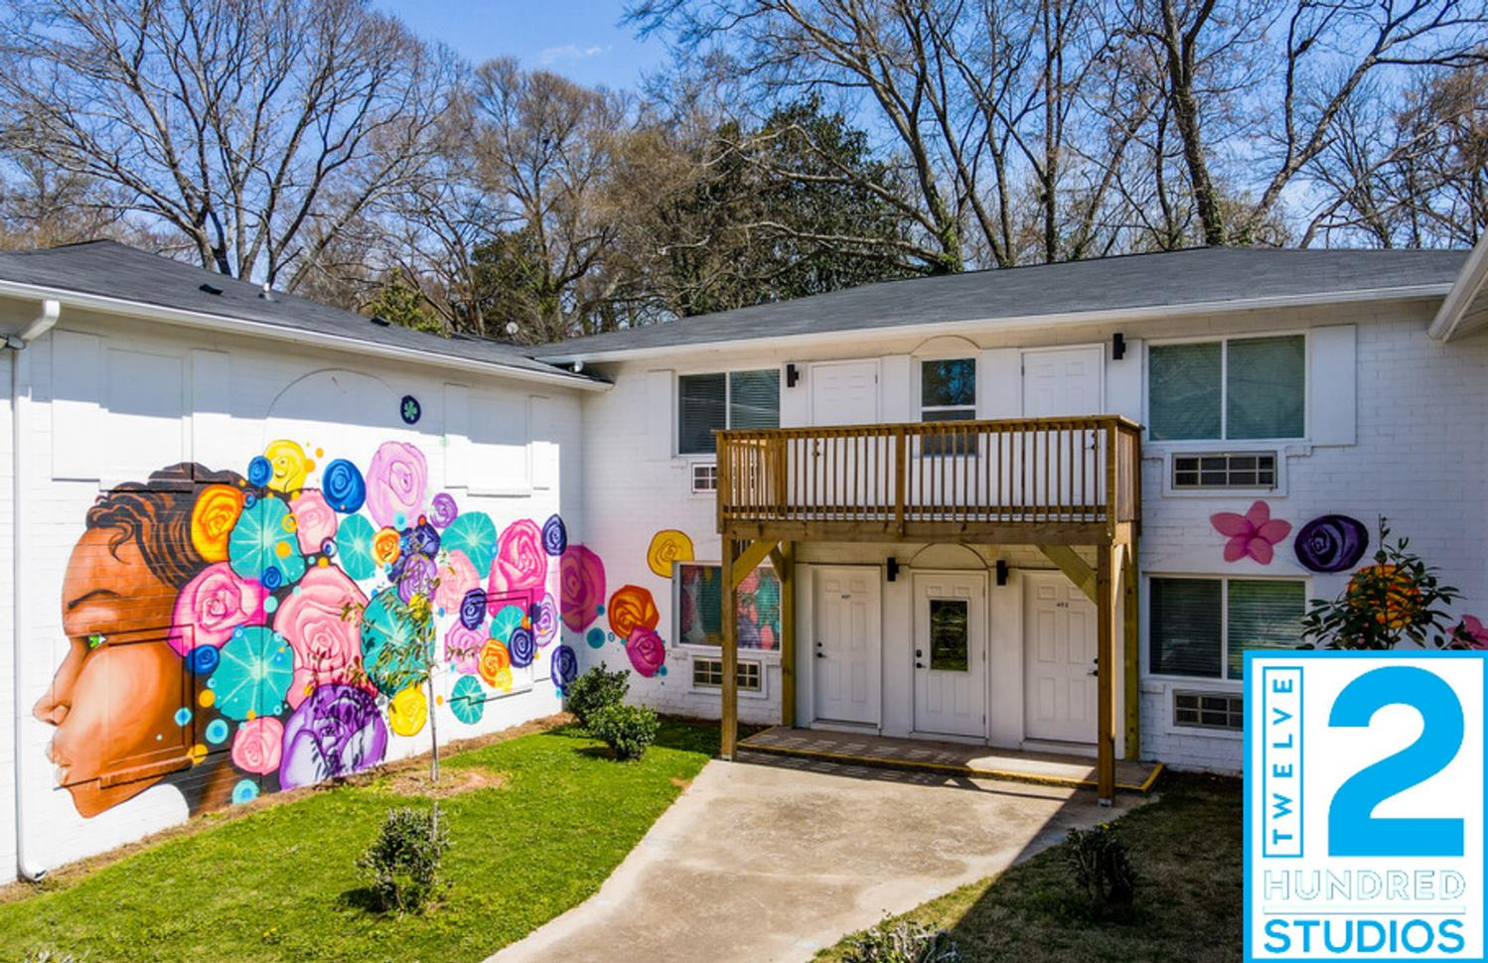
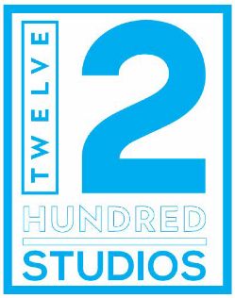
12Hundred Studios
1200 Mobile St. NW, Atlanta, GA 30314

Slide 5
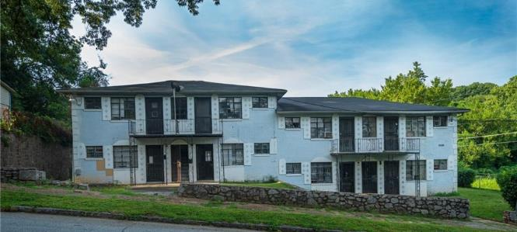


Deal Dynamics
Property at Purchase
Capital Providers
Sources and Uses of Funds
Unit Mix
Uses of Funds | Total ($) | $/Unit (Orig.) | $/Unit (Rehab)
Purchase Price | $1,550,000 | $77,500 | $38,750
Construction Hard Costs | $1,534,110 | $76,706 | $38,353
Other Fees and Costs | $923,852 | $46,193 | $23,096
Total Uses | $4,007,962 | $200,398 | $100,199
Pre-Renovation
Post-Renovation
Sources of Funds | Total ($) | Cap. (%) | Equity (%) | Return¹ | Structure
AAHF | $1,120,000 | 27.9% | NA | 6.0% | Senior Debt
ASREF | $2,600,000 | 64.9% | 90.0% | 8.0% | Preferred Equity
LPs and GPs | $287,962 | 7.1% | 10.0% | Waterfall | Common Equity
Total Sources | $4,007,962 | 100.0% | 100.0% | 7.4%
Notes:
Acquisition, rebranding and repositioning of 1200 Mobile St.
It was a joint venture among ARRC, Alexander Goshen and Tenth Street Ventures
Financed by Atlanta Affordable Housing Fund and American South Real Estate Fund
The property was a vacant apartment complex in an underserved community on Atlanta’s Westside
The purchase price was cost prohibitive, so we took the approach of splitting units—which has numerous benefits which I’ll cover next

Slide 6
Execution Strategy
Plan: Acquisition to Stabilization
Purchase Price Per Unit
Purchase Price Per Square Foot
Central to rehab was converting 20 units into 40 studios
Conversion drops price / unit and better utilizes square footage to drive rent revenue
Analysis: Conversion Effect on Purchase
Converting from 20 to 40 units has a dramatic effect on pricing
Pricing / unit is reduced by 50.0%, falling from $77,500 / unit to $38,750 / unit
Rent Per Unit¹
Rent Per Square Foot
Analysis: Conversion Effect on Total Rent
Converting to 40 units necessitates decrease in rent; however, the increased number of renters yields a substantial boost in total rent revenue
Rent revenue increases from $20,116 to $34,726, representing a 72.8% increase in rent

Slide 7
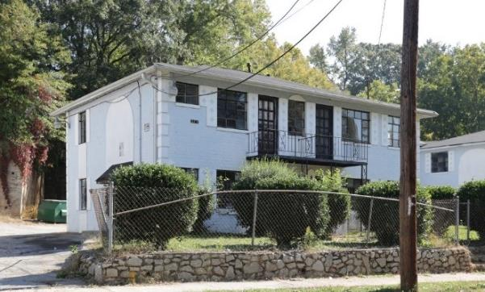
Exterior: Before

Slide 8
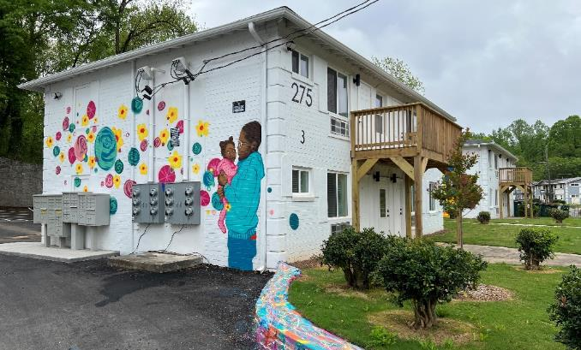
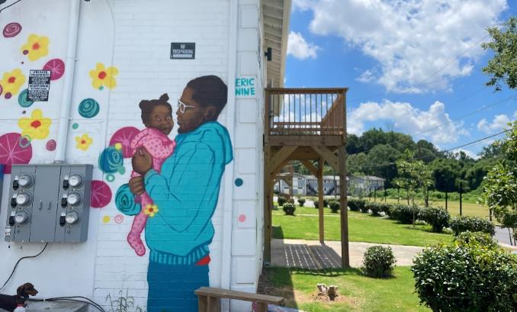
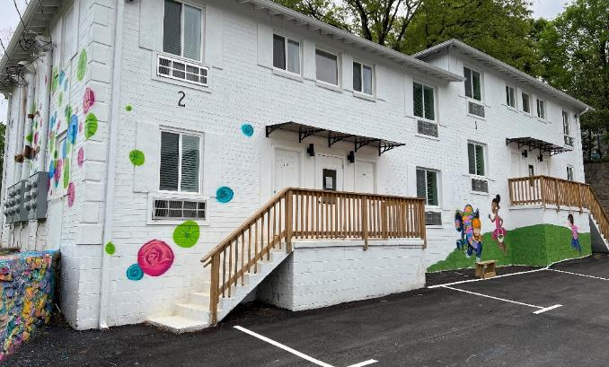
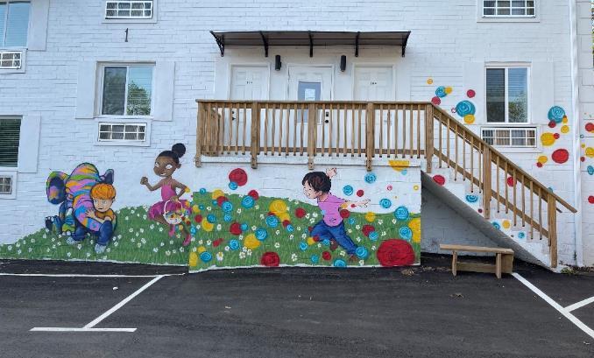
Exterior: After

Slide 9
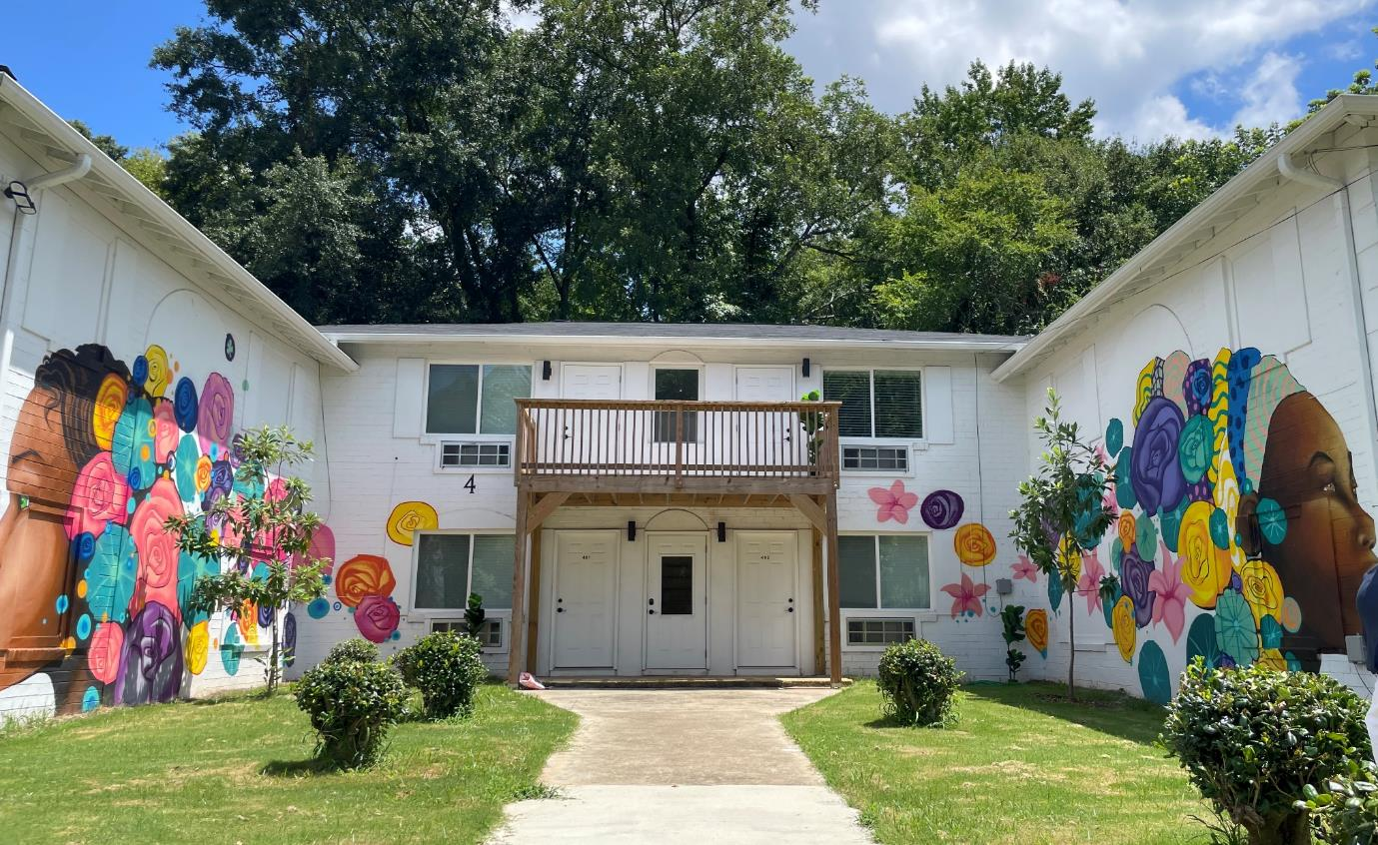
Murals (Cont.)

Slide 10
Interior Construction

Slide 11
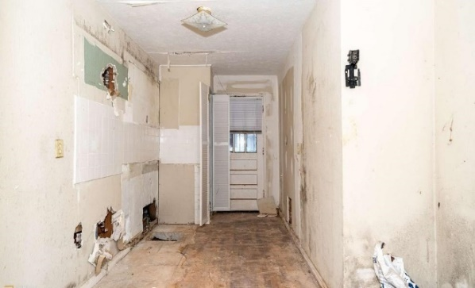
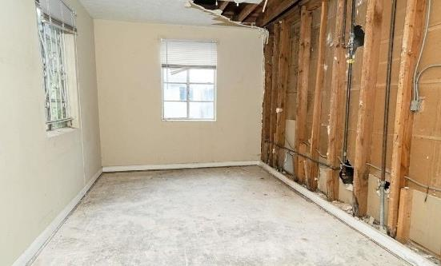
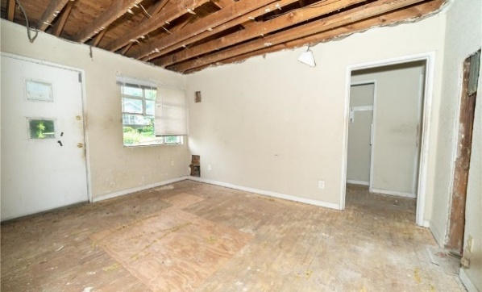
Interior: Before

Slide 12
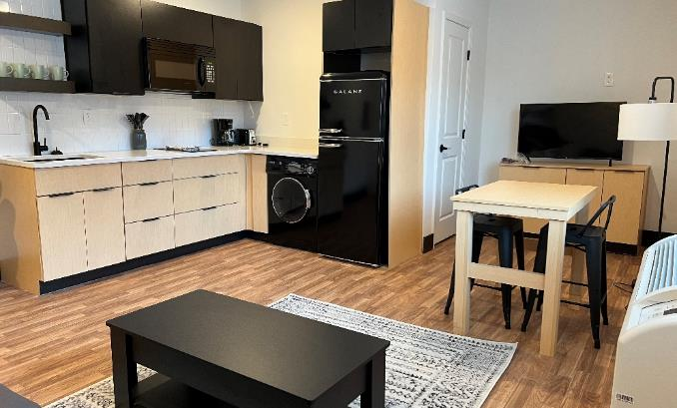
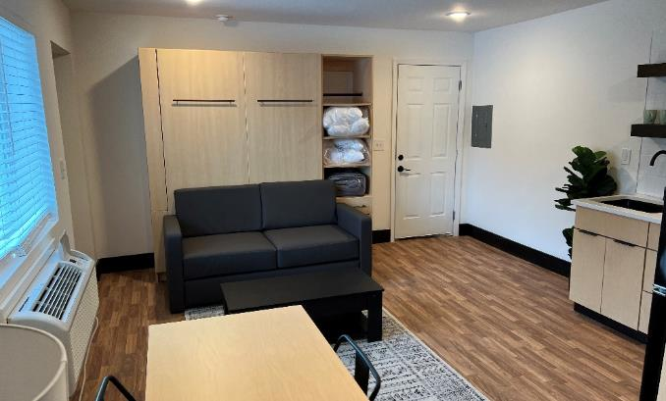
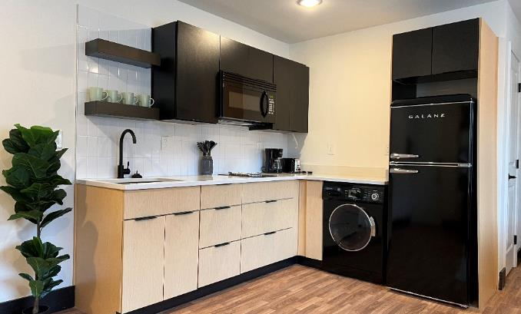
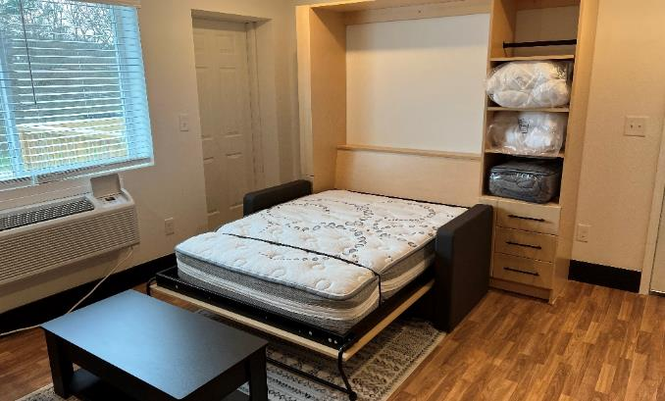
Interior: After

Slide 13
Partnerships

Slide 14
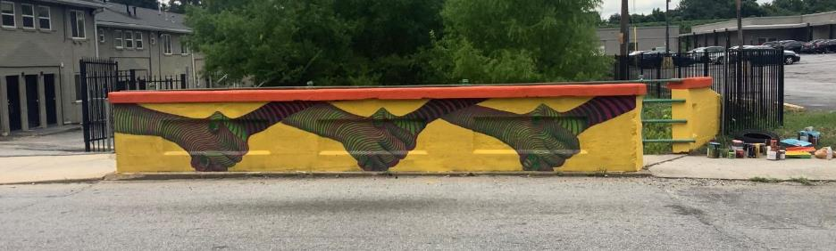
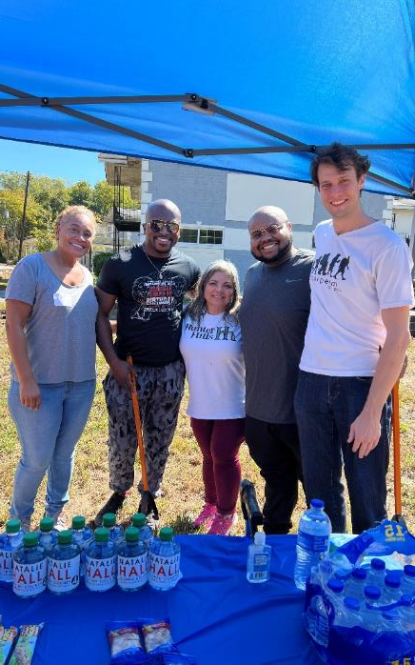
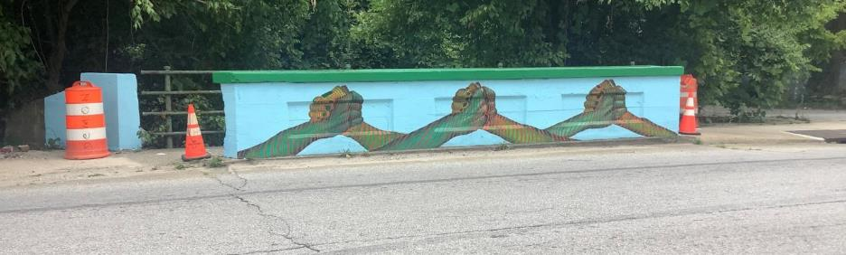
Hunter Hills Neighborhood Association
Murals Over Joseph E. Boone Bridge
Team invested in the community through a creative placemaking initiative
Funded murals painted on the bridge over Proctor Creek on Joseph E. Boone Blvd.
Design and artist voted on by Historic Hunter Hills Neighborhood Association to ensure murals reflect the community
Neighborhood Cleanup Day in Hunter Hills
Owners regularly participate in neighborhood cleanup and beatification initiatives

Slide 15
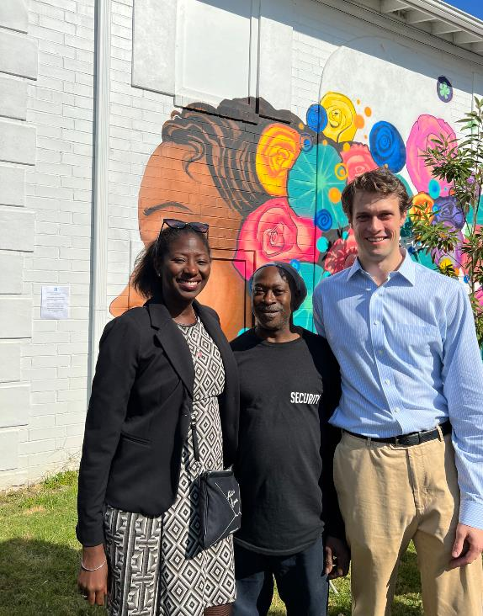
Legacy Resident Partnership
Importance of Legacy Residents
Legacy residents represent an often overlooked and under-engaged demographic that can add substantial value to a project
Their knowledge of the area and stature among the community helps establish bonds that money alone cannot buy
Mr. Anthony Watt—20-year resident of Hunter Hills—became a lynchpin that propelled 12Hundred Studios across the finish line and through stabilization
Beginning as a night watchman during construction, we did not have a single break in or theft under his watch
Stabilization and Ongoing Operations
Due to his success securing the property through construction, we gave Mr. Watt a unit to live in fulltime
He continued securing the property and assisting new residents as lease up progressed, becoming a point of contact to reach members of the community outside the reach of the neighborhood association
In particular, our underserved and vulnerable demographic benefitted as he was familiar with their needs
Ashani O’Mard (ANDP)
Anthony Watt (Legacy Resident)
Richard Taylor (ARRC Capital)

Slide 16
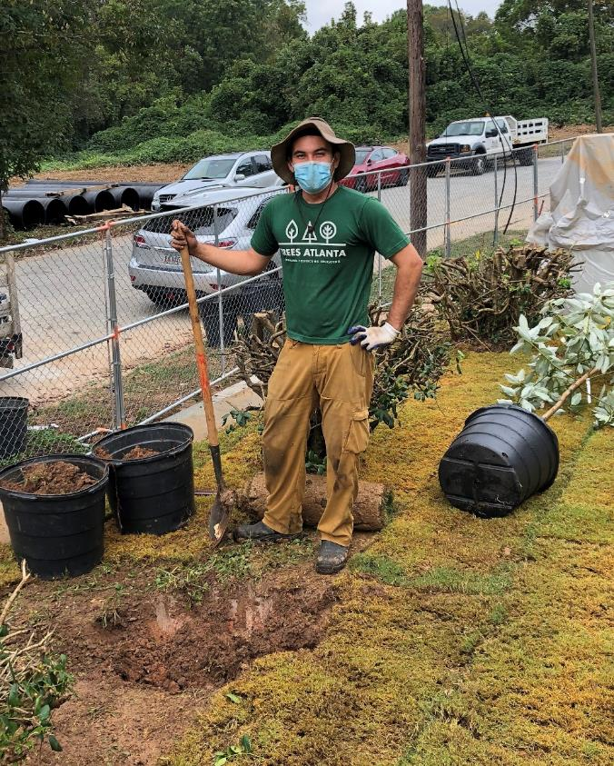
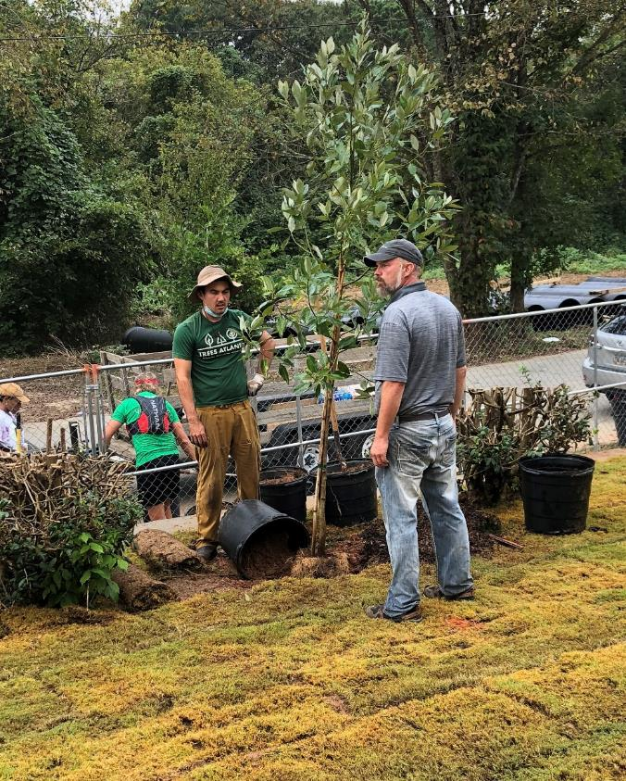
Trees Atlanta Community Planting Day

Slide 17
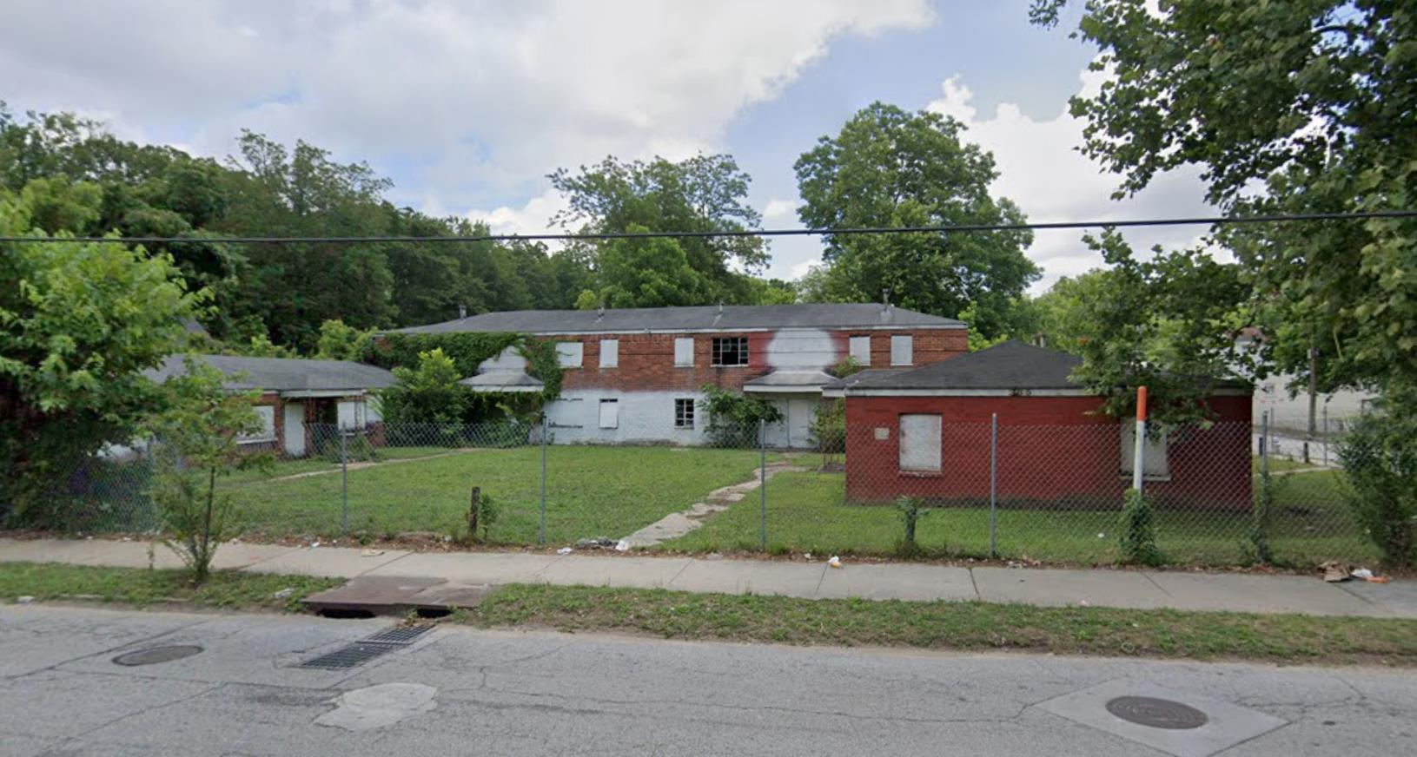
385 Joseph E. Lowery
Confidential Investor Information

Slide 18
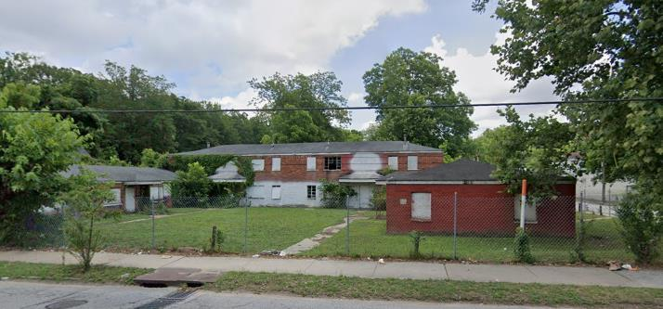



Deal Dynamics
Property at Purchase
Capital Providers
Project Summary
Unit Mix
Uses of Funds | Total | $/Unit
Purchase of Property | $800,000 | $25,000
Construction Hard Costs | $3,668,938 | $114,654
Other Fees and Costs¹ | $1,099,622 | $34,363
Total Uses | $5,568,560 | $174,018
Pre-Renovation
Post-Renovation
Sources of Funds | Total | %
Atlanta Affordable Housing Fund | $950,000 | 17.06%
Westside Future Fund | $3,100,000 | 55.67%
Invest Atlanta Grant | $1,000,000 | 17.96%
Atlanta BeltLine | $42,000 | 0.75%
Required Limited Partner Equity | $518,560 | 9.31%
Total Sources | $5,568,560 | 100.00%

Slide 19
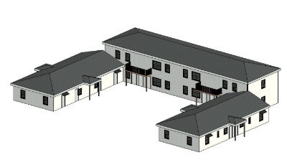
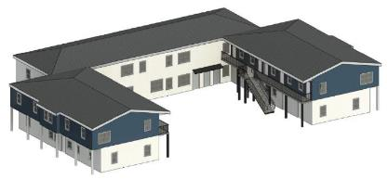
Construction Plans: Current vs. Proposed
Current Layout
Proposed Layout
Unit mix caters to individual renters and students
New unit mix adds additional floor over each single-story portion of the building and expands the unit mix to studios, 1-bed and 2-beds
Unit mix caters to a diverse cohort of renters which spans from students to families
Rent Mix
Layout | Monthly Rent | Sq. Ft. | Count | Affordability*
Studio | $1,073 | 275 | 10 | 60%
Studio | $1,430 | 309 | 2 | 80%
Studio | $537 | 209 | 2 | 30%
Studio | $537 | 289 | 2 | 30%
Studio | $537 | 201 | 2 | 30%
1-Bed | $1,532 | 381 | 1 | Market
1-Bed | $1,532 | 390 | 1 | Market
1-Bed | $1,532 | 333 | 10 | Market
2-Bed | $1,838 | 568 | 1 | Market
2-Bed | $1,838 | 566 | 1 | Market
Total | $1,215 | 313 | 32

Slide 20
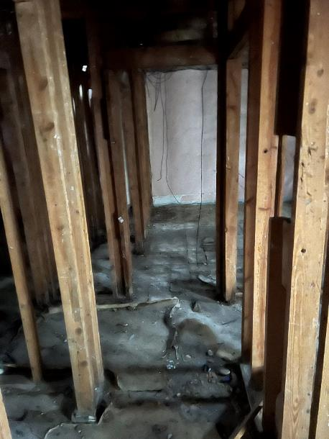
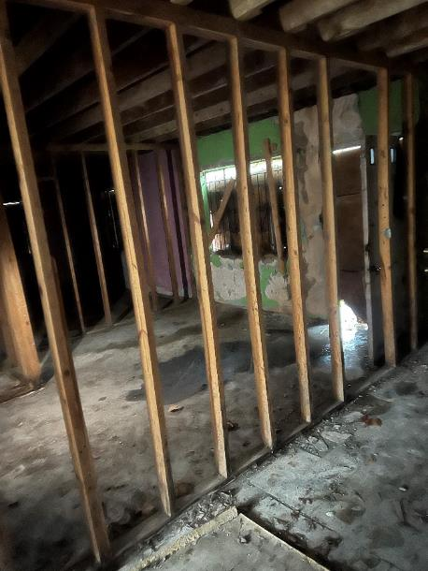
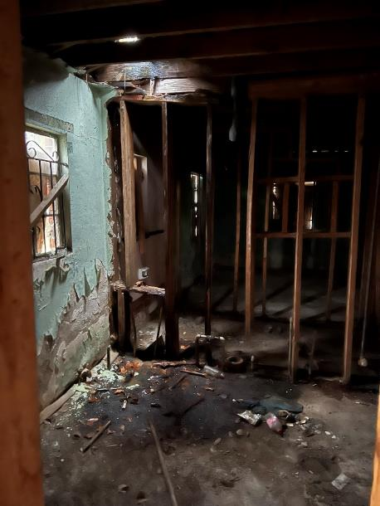
Interior Pictures

Slide 21
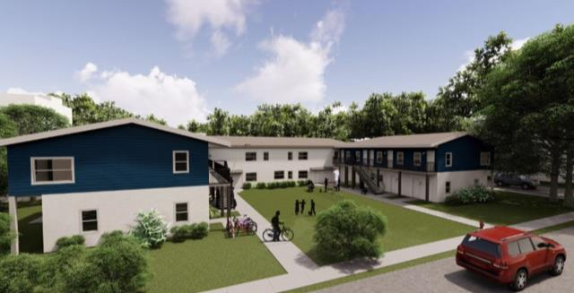
385 Joseph E. Lowery

Slide 22
Partnerships

Slide 23
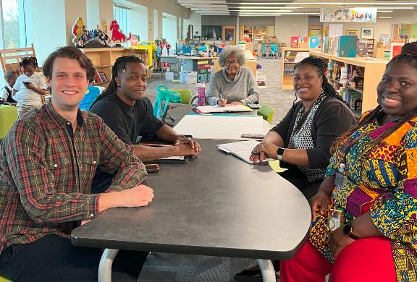
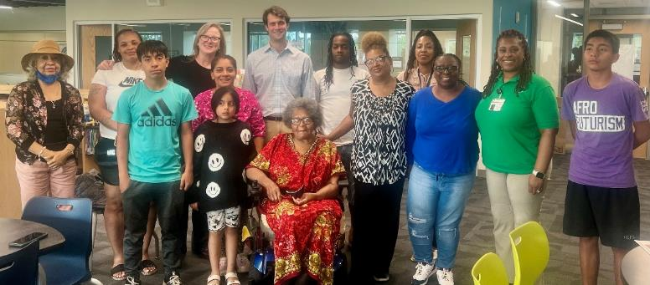
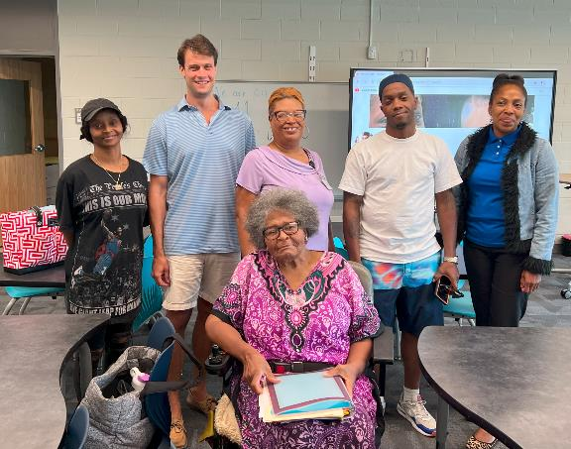
Investment in the Local Elementary School
Summary
We founded the Parent-Teacher association at Hollis Innovation Academy
One of the developers subsequently joined the board of the PTA
Founding of PTA at Hollis Innovation Academy
Establishment of local Parent Teacher Association in partnership with the PTA over all of Atlanta
Seed funding will provide membership for 25 families or 50 individuals

Slide 24
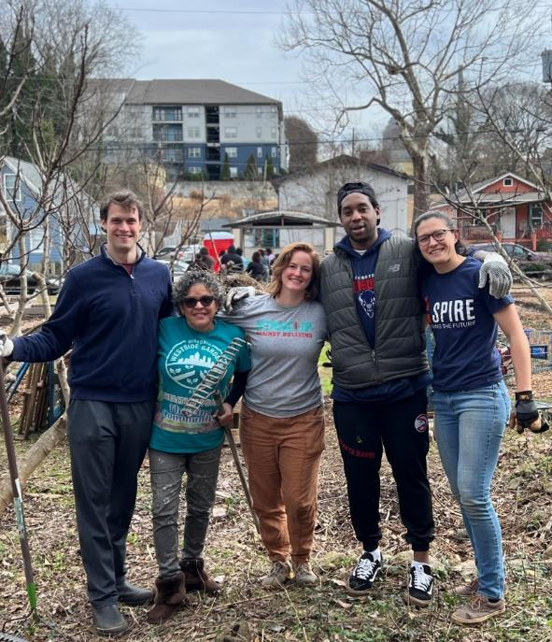
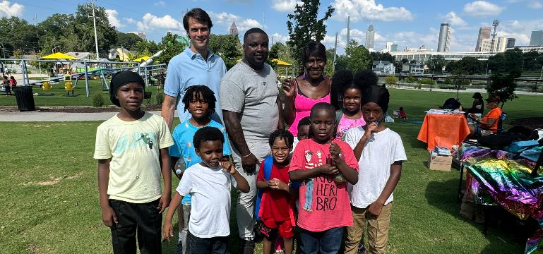
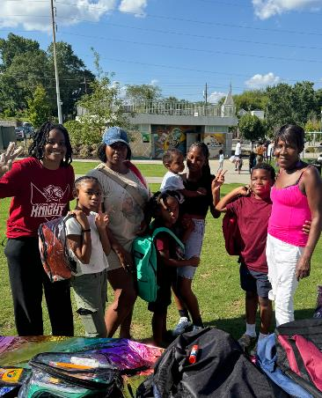
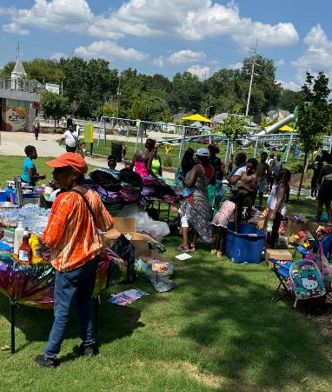
Boots-on-the-Ground Impact
MLK Day of Service at Historic Westside Gardens

Slide 25
Learnings

Slide 26

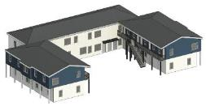
Construction Plans: Beginning vs. Ending
First Proposal
Overview
Structure
Floor Plan
Subsidy Required
Our first proposal was all studio apartments
Layout | Total Units | Affordability | Starting Rent
Studio | 32 | 60% AMI | $1,072
1-Bed | 0
2-Bed | 0
$0
Second Proposal
Our second proposal was a mix of units to support families, requiring an additional story
Layout | Total Units | Affordability | Starting Rent
Studio | 18 | 60% AMI | $1,072
1-Bed | 12 | 60% AMI | $1,149
2-Bed | 2 | 60% AMI | $1,379
$800,000
Third Proposal
Our third proposal was an additional story, rents starting at $537 and better kitchen appliances
Layout | Total Units | Affordability | Starting Rent
Studio | 18 | 30%/60%/80% | $537
1-Bed | 12 | Market | Market
2-Bed | 2 | Market | Market
$1,042,000

Slide 27
Construction Plans: Current vs. Proposed
12Hundred Studios
Joseph E. Lowery
Overview
Renovation of a blighted apartment with all studio units
Renovation of a blighted apartment with studio, 1-bed and 2-bed units
Percent of Units Affordable
100%
56.2%
Subsidy
$0
$1,042,000
Timeline
9 Months
Est. 36 Months

Slide 28
What Can YOU Do?

Slide 29
What Can YOU Do?
Continue to promote the necessity of housing for all
Help people understand that housing comes in many shapes and forms
We can’t do it without you!

Slide 30
